Slide 1
Chapter 4.2
The Quantum Model of the Atom

Slide 2
Electrons as Waves
Scientists of the early twentieth century Questioned:
Why did hydrogen’s electron exist only in orbits
Why couldn’t electrons exist in a limitless number of orbits with slightly different energies

Slide 3
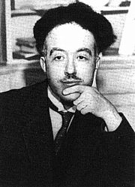

Electrons as Waves
French scientists Louis de Broglie pointed out:
  Suggested that electrons be considered waves confined to the space
Electrons can also be diffracted (bent) or interfere (reduction or increase) in energy

Slide 4
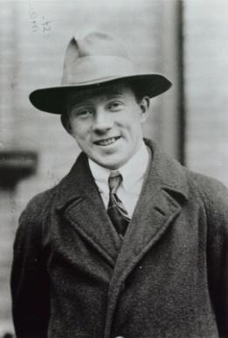
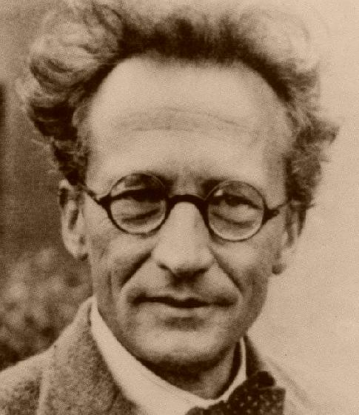
Electrons as Waves??? How???
The idea of electrons being both a wave and particle troubled scientists
If they are both particles and waves, then where are they in the atom???
Werner Heisenberg and Erwin Schrödinger to the RESCUE!

Slide 5
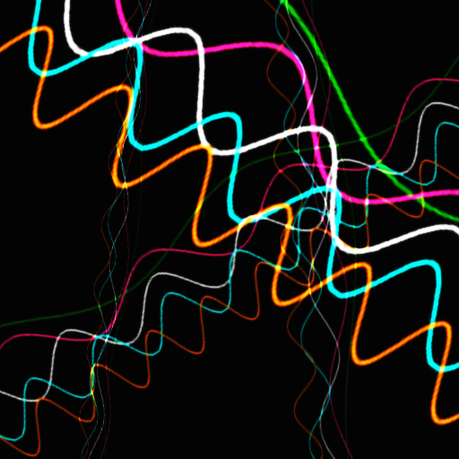
Heisenberg Uncertainty Principle
Electrons are detected by their interaction with photons.
Because photons have about the same energy as electrons, any attempt to locate a specific electron with a photon knocks the electron off its course!

Slide 6
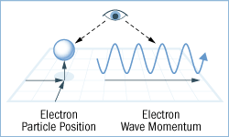
Heisenberg Uncertainty Principle
Therefore Heisenberg uncertainty principle states that it is impossible to determine simultaneously both the position and velocity of an electron!

Slide 7
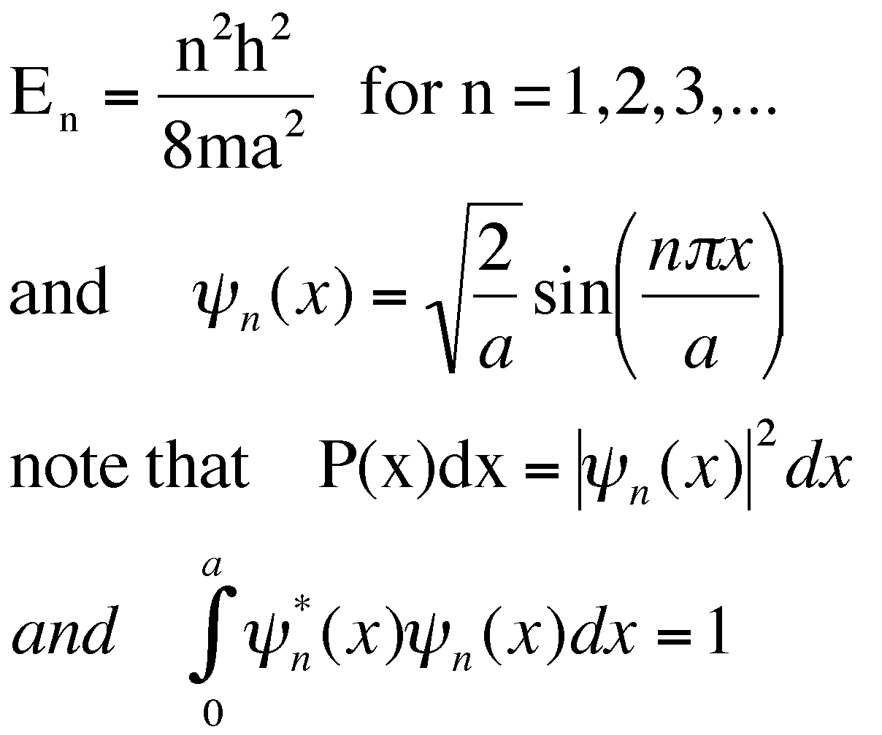
Schrödinger Wave Equation
Austrian physicist Erwin Schrödinger developed an equation that treated electrons in atoms as waves.
Only waves of specific energies (or frequencies) provided solutions to the equation.

Slide 8
Schrödinger Wave Equation
Quantum Theory: describes mathematically the wave properties of electrons and other very small particles

Slide 9
Modern Day Atomic Theory
Based on Heisenberg’s and Schrödinger’s discoveries…
Electrons do not travel around the nucleus in neat orbits, but INSTEAD in an…
orbital: a three-dimensional region around the nucleus that indicates the probable location of an electron

Slide 10
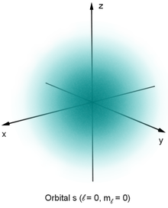
Picture of figure 4-11
The probability of finding the electron is proportional to the density of the cloud
The surface within which the electron can be found a certain percentage of the time

Slide 11
Quantum Numbers (4 quantum #s)
Each number is connected to properties of atomic orbitals and the electrons in that orbital
Different numbers represent different orbitals and therefore give different information
If you know what the numbers mean, you can identify how the electrons are arranged in the atom

Slide 12
Principle Quantum Number (n)
principle quantum number (n) = indicates the main energy level occupied by the electron.
Values of n are positive (1,2,3,…)
As n increases, the electron’s energy and its average distance from the nucleus increases

Slide 13
1. Principle Quantum Number (n)
If an electron has n = 1…
  It occupies the first, or lowest, main energy level and is located closest to the nucleus
  More than one electron can have the same n value
  If they have the same n value, they are in the same electron shell
  The total number of orbitals that exists in a given shell, or main energy level is equal to n²

Slide 14
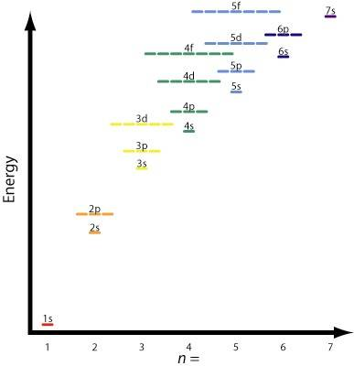
Except at the first main energy level, orbitals of different shapes – known as sublevels – exist for a given value of n

Slide 15
2. Angular Momentum
The angular momentum quantum number (symbolized by the letter l, indicates the shape of the orbital)
The number of orbital shapes possible is equal to n
The values of l allowed are zero and all positive integers less than or equal to n-1

Slide 16
Angular Momentum
The values of l allowed are zero and all positive integers less than or equal to n-1
Example: orbitals for which n=2 can have one of two shapes…l=0 and l= 1
  Depending on its value of l, an orbital is assigned a letter

Slide 17
Orbital Letter Designations According to Values of l
l | Letter
0 | s
1 | p
2 | d
3 | f

Slide 18
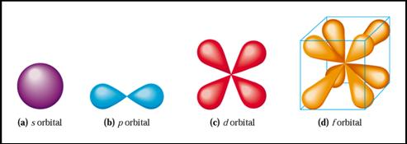
Orbital shapes for s, p, d, & f

Slide 19
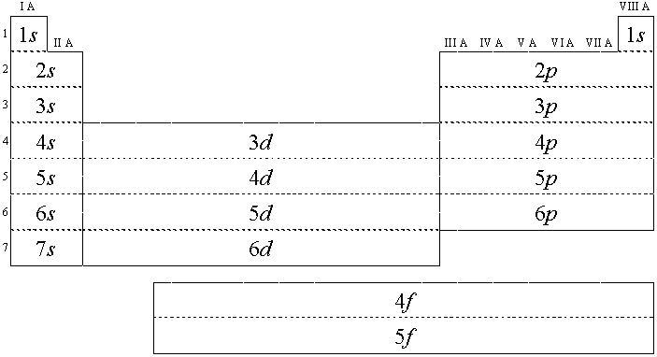

Slide 20
3. Magnetic quantum number
Atomic orbitals can have the same shape but different orientations around the nucleus
Magnetic quantum number, symbolized by m
  Indicates the orientation of an orbital around the nucleus
s orbital is spherical and is centered around the nucleus, it has only one possible orientation

Slide 21
3. Magnetic Quantum Number (m)
s orbitals have only 1 orientation
p orbitals have 3 orientations (m = -1, 0, 1)
d orbitals have 5 orientations (m = -2,-1,0,1,2)
f orbitals have 7 orientations (m=-3,-2,-1,0,1,2,3)

Slide 22
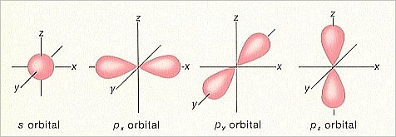
Possible p orbitals
(3 possible p orbitals – x, y, z)
The intersection of the x, y, and z axes indicates the location of the center of the nucleus
m =

Slide 23
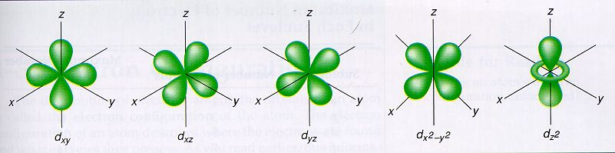
Possible d orbitals
(5 possible d orbitals → xy, xz, yz, x²-y², z²)
Each orbital occupies a different region of space

Slide 24
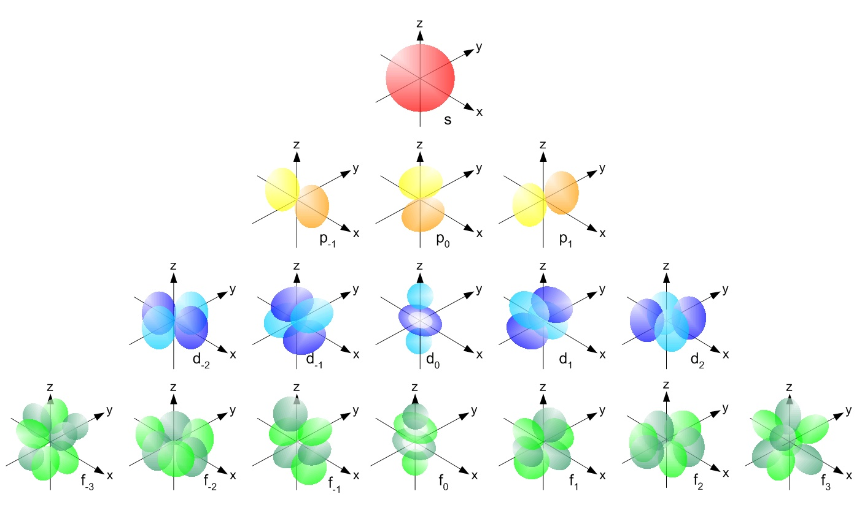
Possible f orbitals
f has 7 possible orbitals

Slide 26
Quantum Numbers
Orbitals combine to form a spherical shape
s orbital
2px orbital
2py orbital
2pz orbital

Slide 28
4. Spin Quantum Number (m_{s})
Electron spin = + ½ or – ½
An orbital can hold 2 electrons that spin in opposite directions

Slide 29
Quantum Numbers
Pauli Exclusion Principle
  No two electrons in an atom can have the same 4 quantum numbers
  Each e- has a unique “address”
  Principal # → energy level
  Ang. Mom. # → sublevel (s,p,d,f)
  Magnetic # → orbital
  Spin # → electron

Slide 30
Quantum Numbers Summary
 | # of shapes | Max electrons | Starts @ energy level
s | 1 | 2 | 1
p | 3 | 6 | 2
d | 5 | 10 | 3
f | 7 | 14 | 4

Slide 31
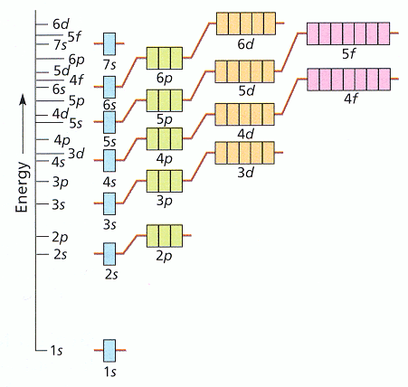
Electron Configurations
Electron Configuration- the way electrons are arranged in atoms
Aufbau principle – electrons enter the lowest energy first
This causes difficulties because of the overlap of orbitals of different energies
“Lazy Tenant Rule”

Slide 32
Electron Configurations
Pauli Exclusion Principle
  No two electrons in an atom can have the same 4 quantum numbers
  At most 2 electrons per orbital – different spins
  Each orbital can hold two electrons with opposite spins

Slide 33
Electron Configurations
Hund’s Rule = when electrons occupy orbitals of equal energy they don’t pair up until they have to
“Empty Bus Seat Rule”
WRONG RIGHT!

Slide 34
Notation
Orbital Diagram
O
8e⁻ 1s 2s 2p
Electron Configuration
1s² 2s² 2p⁴

Slide 35
Notation
Longhand Notation
S 16e⁻ 1s²2s²2p⁶ 3s²3p⁴
Electron Configuration
S 16e⁻ [Ne]3s²3p⁴
Core Electrons
Valence Electrons

Slide 36
Some Definitions
Highest Occupied Level – the electron containing main energy level with the highest principle quantum number
Inner-Shell Electrons – electrons that are not in the highest occupied energy level
Noble-Gas Configuration – an outer main energy level fully occupied, in most cases, by eight electrons

Slide 37
Electron Configurations
Let’s determine the electron configuration for Phosphorus
Need to account for 15 electrons

Slide 38
The first 2 electrons go into the 1s orbital
Notice the opposite spins
Only 13 more to go…

Slide 39
The next electrons go into the 2s orbital
Only 11 more to go…

Slide 40
The next electrons go into the 2p orbital
Only 5 more to go…

Slide 41
The next electrons go into the 2s orbital
Only 3 more to go…

Slide 42
The last three electrons go into the 3p orbitals
They each go into separate shapes
3 unpaired electrons
= 1s²2s²2p⁶3s²3p³

Slide 43
Easy way to remember
7s 7p 7d 7f
6s 6p 6d 6f
5s 5p 5d 5f
4s 4p 4d 4f
3s 3p 3d
2s 2p
1s
1s²
2 electrons

Slide 44
Fill from the bottom up following the arrows
7s 7p 7d 7f
6s 6p 6d 6f
5s 5p 5d 5f
4s 4p 4d 4f
3s 3p 3d
2s 2p
1s
1s² 2s²
4 electrons

Slide 45
Fill from the bottom up following the arrows
7s 7p 7d 7f
6s 6p 6d 6f
5s 5p 5d 5f
4s 4p 4d 4f
3s 3p 3d
2s 2p
1s
1s² 2s²2p⁶3s²
12 electrons

Slide 46
Fill from the bottom up following the arrows
7s 7p 7d 7f
6s 6p 6d 6f
5s 5p 5d 5f
4s 4p 4d 4f
3s 3p 3d
2s 2p
1s
1s² 2s²2p⁶3s²3p⁶4s²
20 electrons

Slide 47
Fill from the bottom up following the arrows
7s 7p 7d 7f
6s 6p 6d 6f
5s 5p 5d 5f
4s 4p 4d 4f
3s 3p 3d
2s 2p
1s
1s² 2s²2p⁶3s²3p⁶4s²3d¹⁰4p⁶5s²
38 electrons

Slide 48
How the First twenty Elements Fill with Electrons
Hydrogen 1,0,0,0
Helium 2,0,0,0
Lithium 2,1,0,0
Beryllium 2,2,0,0
Boron 2,3,0,0
Carbon 2,4,0,0
Nitrogen 2,5,0,0
Oxygen 2,6,0,0
Fluorine 2,7,0,0
Neon 2,8,0,0
Sodium 2,8,1,0
Magnesium 2,8,2,0
Aluminum 2,8,3,0
Silicon 2,8,4,0
Phosphorus 2,8,5,0
Sulfur 2,8,6,0
Chlorine 2,8,7,0
Argon 2,8,8,0
Potassium 2,8,8,1
Calcium 2,8,8,2

