Slide 1
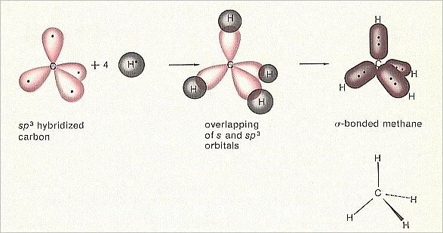
Chapter 6 Chemical Bonding

Slide 2

Chemical bonding
Have you ever found yourself in a crowded environment, ex. a crowded elevator.
When in this situation have you ever experienced a sense of being too close?
When atoms get too close together, electrons repel one another, yet they are strongly attracted to the next atom’s nucleus

Slide 3
Introduction to chemical bonding 6-1
Chemical bond: a mutual electrical attraction between the nuclei and valence electrons of different atoms that binds the atoms together.
The valence electrons are redistributed in ways that make the atoms more stable.

Slide 4
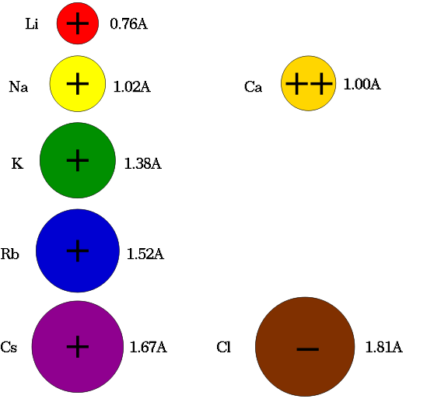
Ions and bonding
Remember…
  Ion = a charged atom/ bonded group of atoms
  a cation = when an atom loses electron(s)
  and an anion = when an atom gains electron(s).
Ionic bond= chemical bonding that results from the electrical attraction between large numbers of cations and anions

Slide 5
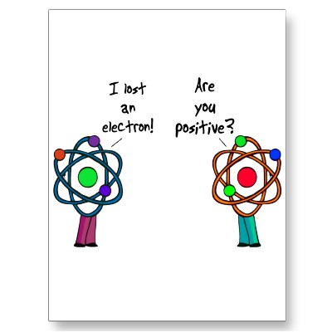
Ions and bonding
Ionic bond= chemical bonding that results from the electrical attraction between large numbers of cations and anions
Usually seen between metals and non metals
In a purely ionic bond; one atom completely gives up electron, and the other completely accepts the electron

Slide 6
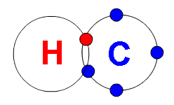
Chemical Bonds
Covalent Bonds: results from sharing electrons
Often seen between two non metals
If a bond is purely covalent; each atom equally shares the electron

Slide 7
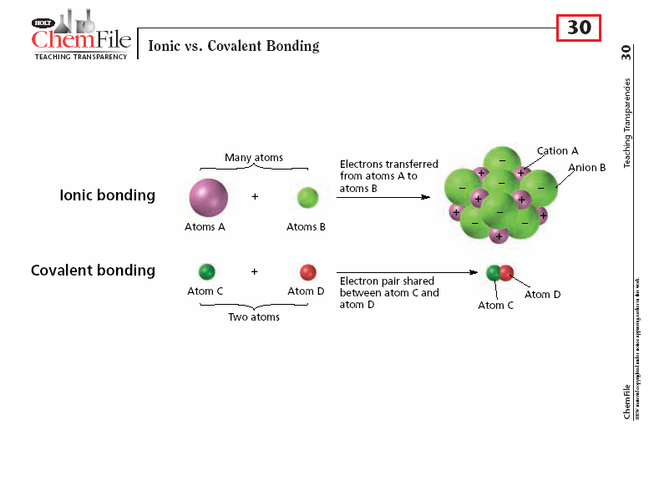

Slide 8
Ionic vs. Covalent
Bonding between atoms of different elements is rarely purely ionic or purely covalent, it is usually in between.
It depends on how strong the atoms of each element attract electrons (electronegativity)
To determine if something is ionic/covalent can be estimated by calcuating the difference in elements’ electronegativities

Slide 9
Ionic vs. Covalent
Example: the electronegativity of F is 4.0, and Cs = .7 (pg. 151); the difference is (4.0-.7=3.3)
According to pg. 162 figure 6-2 it would be Ionic

Slide 10
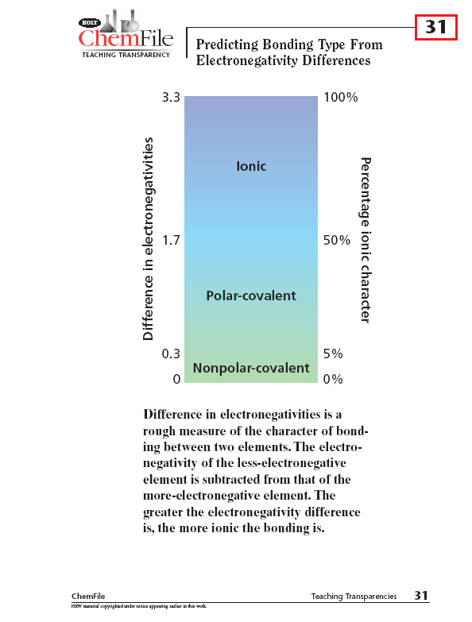

Slide 11
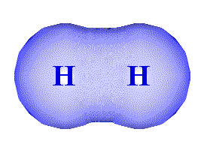
Types of Covalent Bonds
Nonpolar Covalent Bond: a covalent bond in which the bonding of electrons is shared equally by the bonded atoms
Results in a balanced distribution of electrical charge

Slide 12
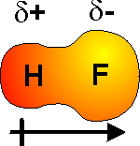
Types of Covalent Bonds
Polar-Covalent Bond: a covalent bond in which the bonded atoms have an unequal attraction for the shared electrons
Results in an unbalanced distribution of electrical charge
One element becomes partially (δ) positive and the other partially negative

Slide 13
Types of Covalent Bonds
How do you know which side is negative or positive?
Look at which element is more electronegative? The element that is more electronegative, has a higher electron density and will be more negative

Slide 14
Ionic or Covalent Problems
Bond between sulfur and hydrogen?
First…what is the electronegativity difference?
    2.5-2.1 =0.4
Second…look on figure 6-2 to see what type of bond
    Polar-covalent
Third…if it is polar covalent, what is the more negative atom?
    Sulfur is more negative

Slide 15
Complete the following table:
Elements Bonded | Electronegativity difference | Bond type | More-negative atom
a. C and H | 0.4
b. C and S | 0.0
c. O and H | 1.4
d. Na and cl | 2.1
e. Cs and S | 1.8

Slide 16
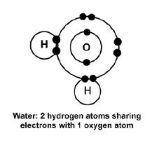
Ionic and Covalent Bond Video

Slide 17
Polyatomic Ions
“Poly” means “more than one”
Usually groups of covalently bonded atoms that have lost or gained electrons
Ex)
  NaOH (Sodium Hydroxide-OH⁻¹)
  (NH₄)₂SO₄ (ammonium sulfate)
  NH₄⁺¹ SO₄⁻²

Slide 18
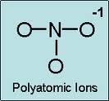

Slide 19
Chapter 6-2 Covalent Bonding and Molecular Compounds

Slide 20
Definitions
molecule: a neutral group of atoms that are held together by covalent bonds
Chemical formula: the relative numbers of atoms of each kind in a chemical compound (uses symbols and subscripts)
Diatomic molecule: a molecule containing only two atoms

Slide 21
More Definitions
Bond length: the avg. distance btwn 2 bonded atoms
Bond energy: the energy required to break a chemical bond and form neutral isolated atoms (kJ/mol)
  Ex. 436 kJ of energy is needed to break the hydrogen-hydrogen bonds in one mole of hydrogen molecules thus forming two moles of separated hydrogen atoms

Slide 22
Bonding electron pair in overlapping orbitals pg. 168

Slide 23
Octet Rule
Octet Rule: chemical compounds tend to form so that each atom, by gaining, losing, or sharing electrons, has an octet of electrons in its highest occupied energy level

Slide 24
Electron-Dot Notation
Electron-dot notation: shows only the valence electrons (outermost electrons) are shown as dots around the element’s symbol
Inner shell electrons are not shown
Ex: fluorine [He]2s²2p⁵ → F

Slide 25
Calculating the number of valence electrons
In general, an elements number of valence electrons can be determined by adding the superscripts of the element’s noble-gas notation.

Slide 26
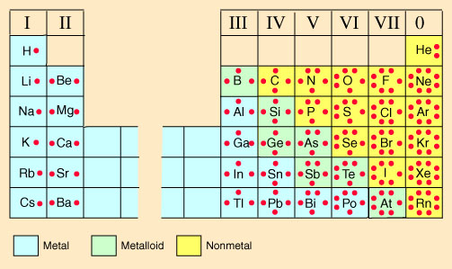
Electron-dot notations for elements with 1-8 valence electrons

Slide 27
Practice:
Write down the electron-dot notation for hydrogen
Write down the electron-dot notation for nitrogen

Slide 28
Lewis Structures
Electron-dot notation can also be used to represent molecules. This is called a Lewis structure (note: I use different colors to represent the electrons from different atoms, you can use (x) and (o) to show the difference.
Ex: H₂ → H H
Ex: F₂ → F F

Slide 29
Lewis Structures
Unshared pair or lone pair is a pair of electrons that is not involved in bonding and belongs exclusively to one atom
Shared pair in a covalent bond is often replaced by a long dash
Ex: H₂ → H H
Ex: F₂ → F F

Slide 30
Lewis Structures
Lewis structures:
  formulas in which atomic symbols represent nuclei and inner-shell electrons,
  dot-pair or dashes between represent covalent bonds,
  and dots adjacent to only one symbol represent unshared electrons

Slide 31
Structural formula
Structural formula: indicates the kind, number, arrangement, and bonds but not the unshared pairs of the atoms in a molecule
Ex: F₂ → F F
The example above represents a single (covalent) bond

Slide 32
Draw the Lewis structure of iodomethane, CH₃I
Practice problem on pg. 171

Slide 33
More practice
Draw the Lewis structure for ammonia NH₃
Draw the Lewis structure for hydrogen sulfide, H₂S
H N H
H
H N H
H
H S H
H S H

Slide 34
Multiple covalent bonds
Double bond: a covalent bond produced by the sharing of two pairs of electrons between two atoms.
Can be shown by either 2 side by side dots or by 2 parallel dashes
All 4 electrons in the double bond “belong” to both atoms.

Slide 35
Double Bonds
Ex: ethene (C₂H₄)
H H H H
C C or C C
H H H H

Slide 36
Triple Bonds
Triple bond: is a covalent bond produced by the sharing of three pairs of elctrons between two atoms.
Nitrogen (N₂) has 5 valence electrons, it shares 3 electrons to complete octet
Ex:
N N or N N

Slide 37
Multiple Bonds
Multiple bonds- double and triple bonds are referred to as multiple covalent bonds
Double bonds have a shorter bond length then single and higher bond energy
Triple bonds have an even shorter bond length then double and higher bond energy than double bonds

Slide 38
Practice problem on pg. 174

Slide 39
More practice
Draw the Lewis structure for carbon dioxide CO₂
Draw the Lewis structure for hydrogen cyanide, which contains 1 hydrogen atom, 1 carbon atom, and 1 nitrogen atom
O C O
H C N

Slide 40
Resonance structures
Resonance: refers to bonding in molecules or ions that cannot be correctly represented by a single Lewis structure
A double headed arrow is placed between a molecule’s resonance structures
Ex: ozone (O₃)
O O O O O O

Slide 41
Ionic Bonding and Ionic Compounds
Remember:
  When an atom loses an electron it becomes positive charge (cation)
  When an atom gains an electron it becomes negative charge (anion)
The ratio of ions in a formula unit depends on the charges of the ions combined
  Example: Two F⁻ needed to balance out one Ca⁺²

Slide 42
Lewis Dot Example pg 177 for chemical rxn of the formation of an ionic bond

Slide 43
Characteristics of Ionic Bonding
Recall: bonds form in nature to minimize potential energy
In an ionic crystal, ions minimize their potential energy by combining in an orderly arrangement known as a crystal lattice
  Attractive forces = oppositely charged ions
  Repulsive forces = like-charged ions and between electrons of adjacent ions

Slide 44
Drawing of Crystal lattice

Slide 45
Polyatomic Ions Lewis Structures
Use [] around the group sometimes to represent The group of atoms as a whole has a positive or negative charge
Example: NH₄⁺ can also be written as [NH₄]⁺

Slide 46
Lewis Dot Polyatomic Examples-pg. 180

Slide 47
Metallic Bonds
Bond formed by the attraction between positively charged metal ions
Electrons move freely from metal atom to metal atom
Form an “electron chain”
This is why metals conduct electricity so well

Slide 48
