Slide 1

Chapter 4
Arrangement of Electrons in Atoms

Slide 2
Starter
Look at the colors on a computer screen. What do you notice?
Close inspection reveals that they are actually made of separate colored dots that our eyes perceive as one color. The study of electrons demonstrates that electromagnetic energy comes in bundles divisible by a quantity called Planck’s constant. Planck’s constant is so small, however, that electromagnetic energy seems to vary continuously, just like the colors on a computer screen.

Slide 3
Objectives
Explain the mathematical relationship among the speed, wavelength, and frequency of electromagnetic radiation
Discuss the dual wave-particle nature oflight.
Discuss the significance of the photoelectric effect and the line-emission spectrum of hydrogen to the development of the atomic model

Slide 4
The Development of a new Atomic Model
The Rutherford model of the atom was an improvement over previous models, but was incomplete
  Did not explain where the atom’s negatively charged electrons are located in the space surrounding its positively charged nucleus
  What prevented the negative electrons from being drawn into the positive nucleus?

Slide 5
The Development of a new Atomic Model
In the early 20th century, a new atomic model evolved as a result of investigation into the absorption and emission of light by matter.
  The studies revealed an intimate relationship between light and an atom’s electrons.
  This new understanding led directly to a revolutionary view of the nature of energy, matter, and atomic structure.

Slide 6
Wave Description of Light
Visible light is a kind of electromagnetic radiation, which is a form of energy tat exhibits wavelike behavior as it travels through space.
Together, all the forms of electromagnetic radiation form the electromagnetic spectrum

Slide 7
Wave Description of Light
Wavelength (λ) – length of one complete wave
Frequency (v) - # of waves that pass apoint during a certain time period
  Hertz (Hz) = 1/s
Amplitude (A) – distance from the origin to the trough or crest

Slide 8
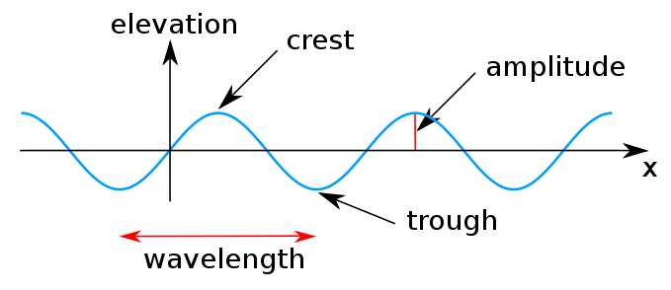
Wave Description of Light

Slide 9
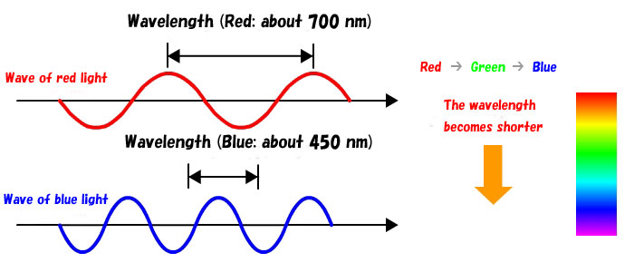
The Wave Description of Light

Slide 10
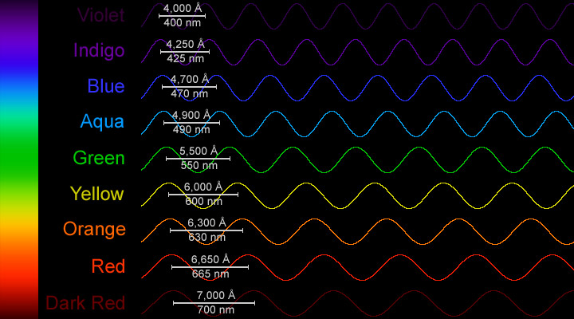

Slide 11
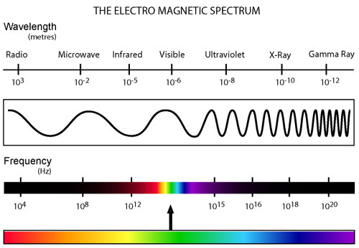
Electromagnetic Spectrum

Slide 12
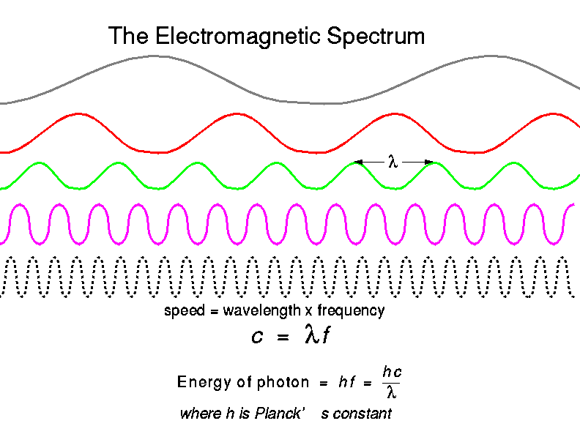

Slide 14
Wave Description of Light
Frequency & wavelength are inversely proportional
c: speed of light (3.00 • 10⁸ m/s
λ: wavelength (m, nm, etc…)
v: frequency (Hz)
c = λv

Slide 15
The Wave Description of Light
Ex. Find the frequency of a photon with a wavelength of 434 nm.
Given: | Work:
v = ? λ = 434 nm = 434 • 10⁻⁷ m c = 3.00 • 10⁸ m/s | v = c/λ v = 3.00 • 10⁸ m/s 4.34 • 10⁻⁷ m v = 6.91 • 10¹⁴ Hz

Slide 16
The photoelectric effect: electromagnetic radiation strikes the surface of the metal, ejecting electrons from the metal and creating an electric current

Slide 17

quantum
quantum: the minimum quantity of energy that can be lost or gained by an atom
Planck’s constant: an object emits energy in small, specific amounts
h = 6.626 x 10^-34 J•s

Slide 18

Photons
Photon: a particle of electromagnetic radiation with zero mass and carries a quantum of energy
E_{photon} = hv
h = planks constant
v = frequency

Slide 19
Hydrogen-Atom Line-Emission Spectrum
When current is passed through a gas at low pressure, the potential energy of some of the gas atoms increases
ground state: lowest energy state of an electron
excited state: higher potential energy than ground state
When an excited atom returns to its ground state, it gives off the energy it gained in the form of electromagnetic radiation

Slide 21
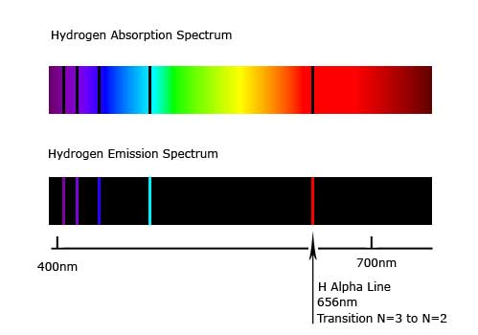
Hydrogen-Atom Line-Emission Spectrum
line-emission spectrum: a narrow beam of the emitted light was shined through a prism, it was separated into a series of specific frquencies

Slide 22
Hydrogen-Atom Line-Emission Spectrum
It was expected that hydrogen would give off a continuous spectrum, but it only gave off specific frequencies of light?
Whenever an excited atom falls back from an excited state to its ground, it emits a photon
The photon’s energy is = difference in energy between the atom’s initial and final state
You can find the wavelengths and then determine the amount of energy

Slide 23
Bohr Model of the Hydrogen Atom
Linked the atom’s electron with photon emission
When an electron is in orbit, it has fixed energy
The closer you are to the nucleus, the less energy
Farther from nucleus = more energy

Slide 24
When electrons absorb energy, they get excited and move up a level, eventually they release gained energy (_______) and move back down level to rest

